Slide 1
Medusa Implementation
By:
Sepand Haghighi
Vahid Amini
Amin Fotovat

Slide 2
Overview
Previous Talk
Implementation
Results

Slide 3
Let’s Flashback!
Why graphs?
Many real-world applications:
Social Networks
Web link analysis
Challenging CUDA code?
Solution: Sequential Programming Framework

Slide 4
GPU As An Accelerator
GPU-based solutions vs CPU-based
Improved performance
Limited to specific graph operations
Optimization for each graph processing task

Slide 5
What Medusa Offers
A Soft Framework
Simplify Programming
Novel Graph Programming Model
Edge-Message-Vertex
Suitable for Parallel Graph Processing

Slide 6
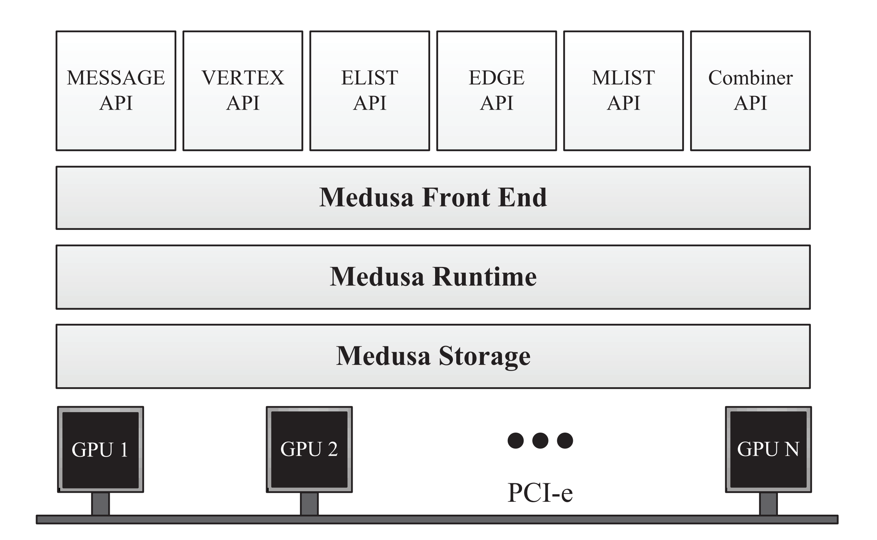
Overview of Medusa

Slide 7
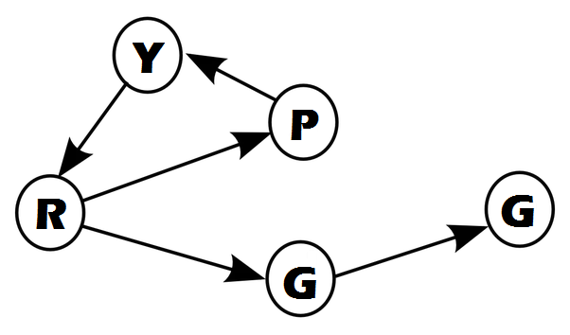
Python Random Graph Generator
Based on DIMACS
Written in Python
Available on our repo (Github)
http://github.com/sepandhaghighi/pyrgg

Slide 8

DIMACS Standard
A graph contains n nodes and m arcs
Nodes are identified by integers 1...n
Graphs can be interpreted as directed or undirected
Graphs can have parallel arcs and self-loops
Arc weights are signed integers

Slide 9
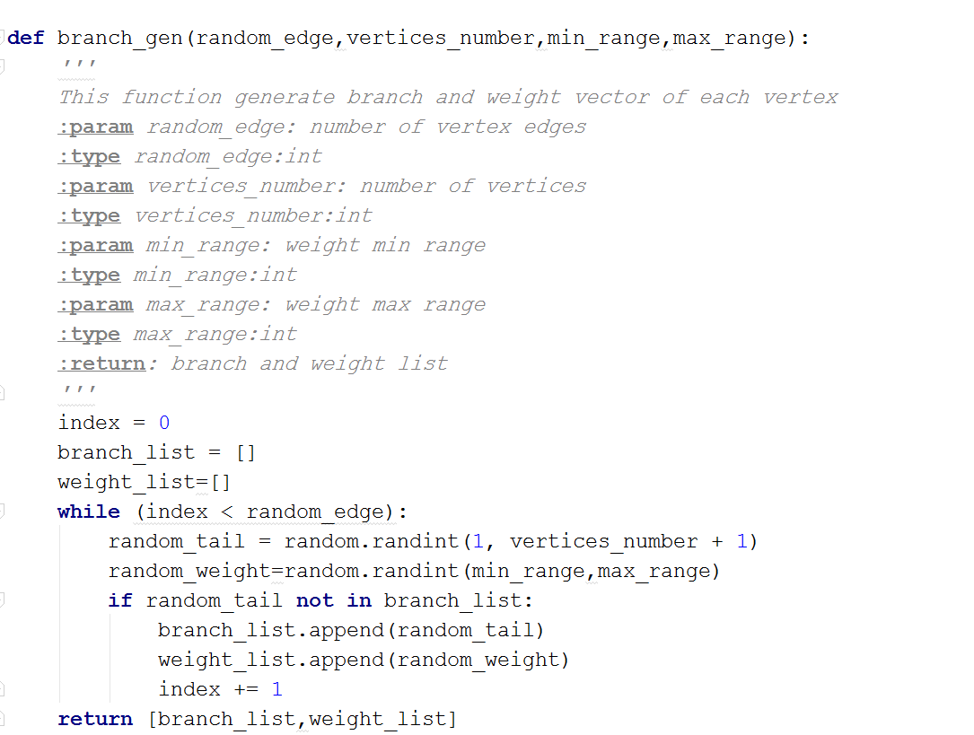
Pyrgg (branch_gen)

Slide 10
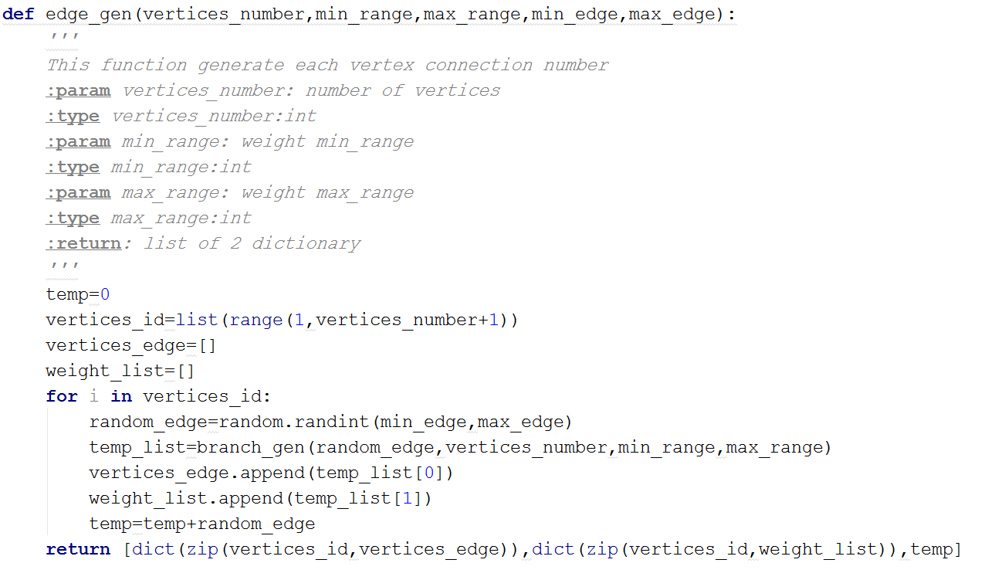
Pyrgg (edge_gen)

Slide 11
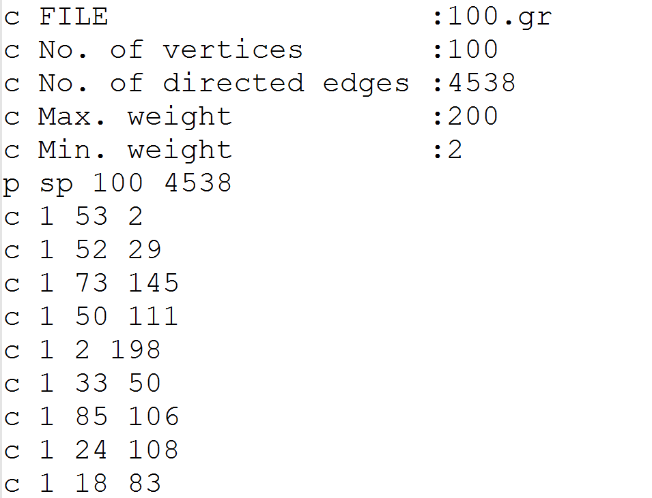
Output

Slide 12
Requirement
Programming
CUDA 7.5
C++ 03
Build
gcc
CUDA nvcc

Slide 13
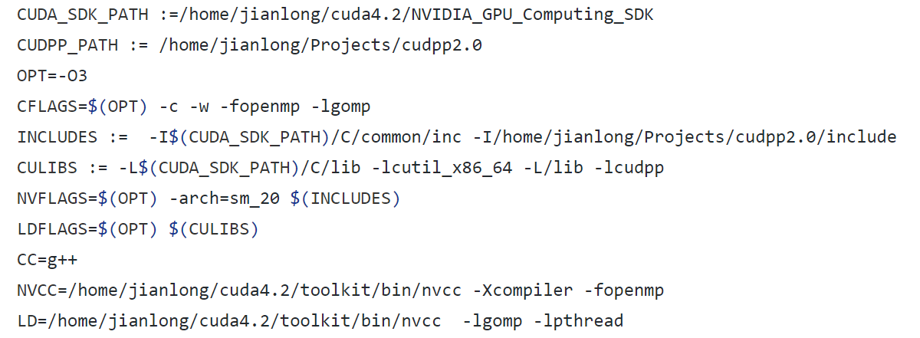
How to build

